Slide 1
Basic Details of the Team and Problem Statement
Team Number: HT037
SDG Goal : Good Health and Well-Being
Problem Statement Title: ACCIDENT PREDICTION
Team Name: Accident Prediction
HACK@SRET 2022

Slide 2
Idea/Approach Details
Traffic safety has always been an important issue in sustainable transportation development, and the prediction of traffic accident severity remains a crucial challenging issue in the domain of traffic safety.
To improve traffic safety management and control, it is necessary to seek timely and accurate methods for predicting traffic accident severity.
Accurate traffic accident severity prediction plays an important role in improving traffic safety management, because, based on accurate prediction, the prominent influencing factors in high-risk road sections could be found out to provide beneficial suggestions for improving road safety.

Slide 3
Idea/Approach Details
Patterns involved in dangerous crashes could be detected by developing prediction model that automatically classifies the type of injury severity of various traffic accidents.
These behavioral and roadway patterns are useful in the development of traffic safety control policy.
It is important that measures should be based on scientific and objective surveys of the causes of accidents and severity of injuries.
The system presents model to predict the severity of
injury that occurred during traffic accidents using machine- learning approach.
The prediction of traffic accident severity provides emergency responders with crucial information for estimating the potential impacts and implementing timely accident management strategies.

Slide 4
SOURCE OF DATASET:
https://github.com/abdulwahed786/final-yr-projectqA

Slide 5
DATASET DESCRIPTION:
First combine accidents and vehicles datasets using merge() method.
The dataset contains 53 columns and 109135 entries.
After removing the rows containing null values using dropna() method,our dataset finally contains 53 columns and 14027 entries.
The dataset contains columns like:
Accident_Index
Location_Easting_OSGR
Location_Northing_OSGR
Longitude
Latitude
Accident_Severity: 1-Fatal,2-Serious,3-Slight
Road_Type:1-Roundabout,2-One way street,3-Dual carriageway,
6-Single carriageway,7-Slip road,9-Unknown
Road_Surface_Conditions:1-Dry,2-Wet or damp,3-Snow,4-Frost or ice,
5-Flood over 3cm. Deep
Skidding_and_Overturning:0-None,1-Skidded,2-Skidded and overturned,
5-Overturned
Weather_Conditions:1-Fine no high winds,2-Raining no high winds,
3-Snowing no high winds,4-Fine + high winds,5-Raining + high winds,
6-Snowing + high winds,7-Fog or mist,8-Other,9-Unknown, etc.

Slide 6
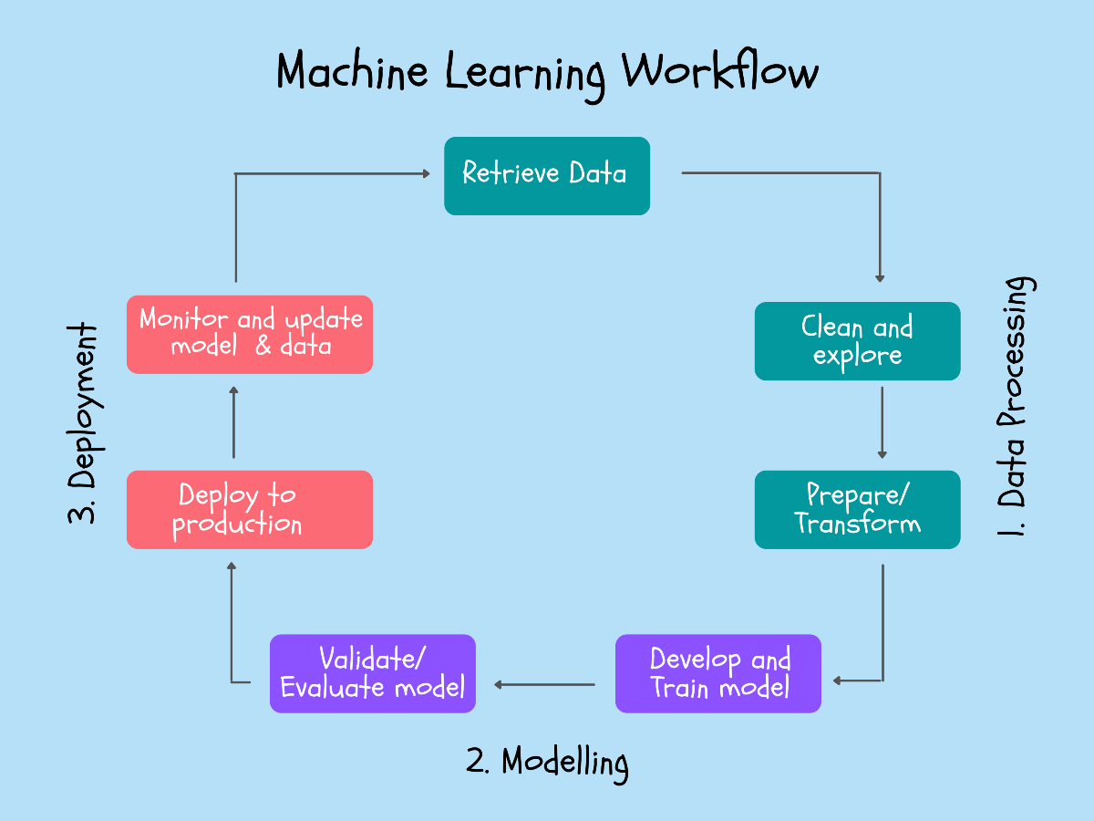
WORKFLOW:

Slide 7
TOOLS AND TECHNOLOGY USED:
PYTHON
STREAMLIT
GITHUB

Slide 8
Idea/Approach Details
DEPENDENCIES:
Using github the dataset has been fetched.
Accident severity prediction depends on factors 'Longitude','Latitude','Number_of_Vehicles','Number_of_Casualties','Road_Type','Speed_limit','Weather_Conditions','Road_Surface_Conditions','Skidding_and_Overturning'
Streamlit to deploy the code.
CHALLENGES:
The merged dataset contained many missing values in the form of NAN and –1 .So filling the Null values became was challenging.
Traffic accident data, which are composed of several to dozens of features, have the characteristics of high dimensions, nonlinearity, and multicollinearity. Hence, developing an accurate method for the prediction of traffic accident severity is a challenging task.
Choosing the best model for prediction.
Choosing the best way to deploy the model.
Deployment of code using Streamlit was time-taking.
USE CASE:
Traffic accident severity prediction plays an important role in improving traffic safety management, because, based on accurate prediction, the prominent influencing factors in high-risk road sections could be found out to provide beneficial suggestions for improving road safety.
Analyze the previously occurred accidents in the locality and predict accident severity which will help us to determine the most accident-prone area and helps us to set up the immediate required help for them.

Slide 9
Uniqueness of The Solution
Traffic accidents are a major threat that has induced enormous human injury and economic losses.
The World Health Organization indicates that over 1.2 million lives have been lost and 50 million people have been injured owing to road traffic accidents
The prediction of traffic accident severity provides emergency responders with crucial information for estimating the potential impacts and implementing timely accident management strategies.
With predicting accident severity, we can take immediate action to save the lives of the casualties thus decreasing the number of deaths caused by accidents.

Slide 10
Impact and scalability
The analysis of accident severity prediction for traffic crash is essential for enhancing the crash rescue responding speed, thereby reducing the casualties and property losses caused by roadway crashes.
It is necessary to select variables which are easily obtained and have significant impact on crash severity levels.
The occurrence rate of death and injury due to road traffic accidents is rising increasingly globally day by day. So predicting accident severity with the help of factors that affects the accident severity will be very useful since it can be helpful to take immediate actions so as to save the lives of the casualties.
This can be done easily by immediately predicting the severity level once the accident happens using the model and taking the necessary actions.
In future, this model can also be used to automatically predict the severity level of the casualty in an accident by using sensors which automatically tracks the factors like Weather conditions, Road surface conditions, etc. and this model can be designed to consider the other factors like speed at which the vehicle was moving at the accident time, speed of the opposite vehicle(in case of crash accidents),etc to predict the severity.

Slide 11
Demonstration Video
https://drive.google.com/file/d/17JSahrMopfbvOcq937ur-kBFWeZ1cLYa/view?usp=sharing

Slide 12

TEAM MEMBERS

